Slide 1
Using Containers Securely
James Relph

Slide 2
People who don’t like snakes should look away for a minute!
Notes:
So I’ve done this talk a few times now and it’s gone down well, so I thought I’d spice it up a bit by adding those two things everybody loves in a presentation - pictures of snakes and audience participation.

Slide 3

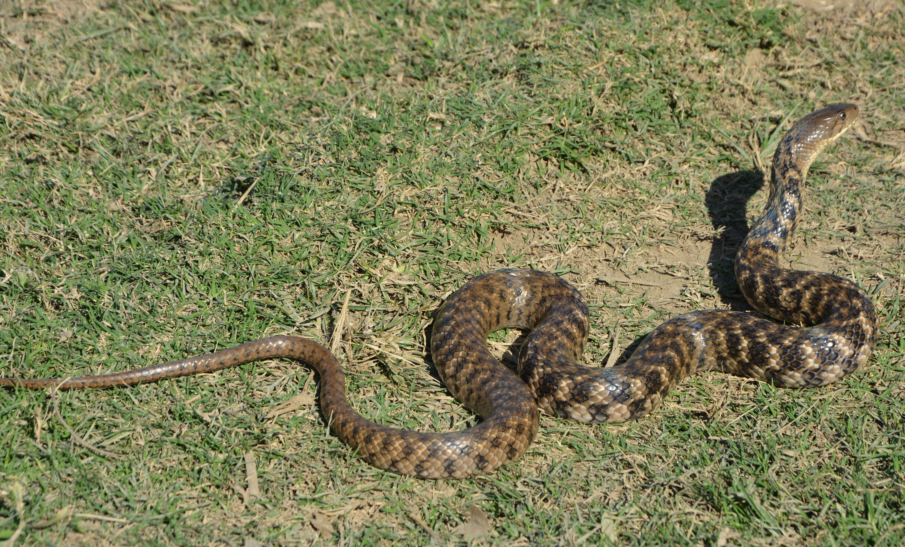
The most poisonous snake in the world
Notes:
The checkered Keelback

Slide 4

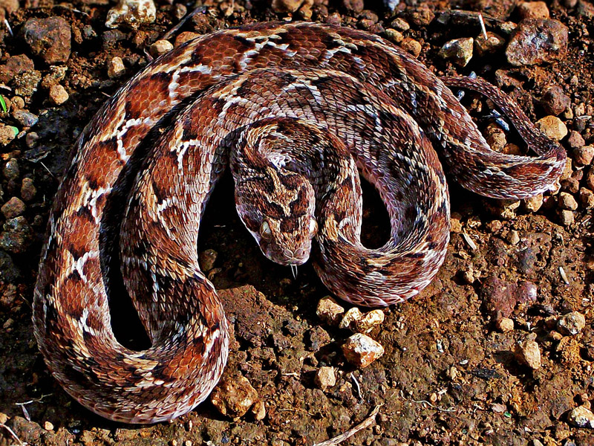

Notes:
The snake on the right isn’t poisonous at all - so which would you rather have as a pet?

Slide 5

Notes:
The saw scaled viper is responsible for more deaths than any other snake in the world. It is a highly venomous snake in - but not poisonous - eat it, and you’ll be fine.

Slide 6
poisonous
/ˈpɔɪzənəs/
adjective
(of a substance or plant) causing or capable of causing death or illness if taken into the body.
venomous
/ˈvɛnəməs/
adjective: venomous
(of an animal, especially a snake) secreting venom; capable of injecting venom by means of a bite or sting.

Slide 7
A few salient points…
Don’t eat Keelback snakes.
Double-check with a pet store if they’re really trying to sell you a snake which they guarantee you isn’t poisonous at all.
Context and background information are both very important.
Notes:
So I think the first two really are worth bearing in mind, however it’s the latter point that I wanted to raise.

Slide 8
Digital Platform Engineering
UK Digital Platform Engineering Unit
Working across a number of sectors and technologies
We’re always on the lookout for skilled Platform Engineers!
I do a LOT of interviews
Notes:
So, some context from me. I work in… We’re seeing clients move rapidly towards containerised infrastructure, some of our clients have moved almost entirely. I’m currently on a project for part of the UK Government which is around 90% containerised, running Docker containers in Kubernetes. As a result one of the key questions I ask at interviews is…

Slide 9
The Question
“What are the differences between a container and a traditional Virtual Machine?”
Notes:
I love this question, and it feels like a general “how well do you know your stuff” question - but, this is about getting to grips with what people understand is the context and background for Docker. In my view you can’t use Docker successfully or securely if you don’t understand how it works. In this talk I’m going to be talking about some basic container security concepts that lead on from this - there are entire other talks that cover things like how JVMs interact with Docker and Kubernetes, or running NodeJS applications inside Docker.

Slide 10
The Answers
“Containers are smaller”
“Containers are lighter”
“Containers are faster”
“Containers are more secure”
“You can get them easily from the internet”
Notes:
I think there’s only one actual quote on this list that is generally true. Getting these wrong can have a dramatic impact on the usability and security of your containers

Slide 11
What this talk covers
What containers are and how they differ from VMs
Implications for security
Implications for operations
The DevOps methodologies they enable
Notes:
Ask how many people have used containers, and are using them in production.
What containers are, and how they differ from VMs

Slide 12
What is a Container?
A container is a standard unit of software that packages up code and all its dependencies so the application runs quickly and reliably from one computing environment to another
—Docker
Notes:
3 minutes
This is quite Docker specific, and covers many of the goals that Docker tries to achieve, but historically and currently this is questionable.

Slide 13
What is a “Traditional” VM?
Tier 1
Tier 2
Hardware
Hardware
Hypervisor
Host OS
VM Software
Guest OS
Guest OS
Guest OS
Guest OS
Guest OS
Guest OS
Guest OS
Guest OS
Guest OS
Guest OS
App
App
App
App
App
App
App
App
App
App

Slide 14
Linux KVM
Tier 1?
Hardware
Hypervisor
Host OS
Guest OS
Guest OS
Guest OS
Guest OS
Guest OS
App
App
App
App
App
Notes:
KVM is interesting as it’s a kernel module and is more of a Tier 1 than a Tier 2 because it directly operates with the hardware and has some controls in place to share access with the Linux kernel itself.

Slide 15
Container Architecture
Hardware
At a high level this looks similar to a Tier 2 VM - the difference is that each of the containers shares the same kernel and system resources as other containers and the host - they do not contain their own kernel. They use Linux features such as cgroups and network namespaces to isolate processes.
While not having a kernel they do contain the libraries and binaries required.
Host OS
Container Software
Container
Container
Container
Container
Container
Notes:
The container software (jails, LXC etc.) can be part of the OS as well. The filesystem approach is quite clever, using a layering approach to capture changes and also to reduce disk space used by sharing layers between images. SELinux / AppArmour can be in here to provide an extra level of security as well.

Slide 16
FROM
FROM ubuntu:18.04
COPY . /app
RUN make /app
CMD python /app/app.py
Notes:
The FROM at the beginning of a Dockerfile is pulling the libraries and binaries that ubuntu uses (in this case), not the Ubuntu kernel.

Slide 17
VM Security
VMs have more isolation between different guests.
Not infallible (eg. Spectre, Rowhammer).
The Hypervisor/Host and guests each need monitoring, and each guest often has a large attack surface.
The added overhead of managing VMs can impact security - they have to be managed with tools like Ansible, Puppet etc - or with something like Packer to create consistent images.
Notes:
6m in
A complete breach in one guest does not give access to the Hypervisor or to other guests.
Spectre and Rowhammer are obviously significantly higher barriers. If you are wore
Using Ansible, Puppet etc. means you have another “ops” tool to use, learn, maintain etc.

Slide 18
Container Security
Containers can be escaped or may leak data DEMO
Layering of security vulnerabilities (ie. each container has an attack surface that due to the lower isolation impacts each other container).
Containers generally have a smaller attack surface.
The speed and simplicity of updating a container can mean that updated versions can be introduced more frequently (eg. a Dockerfile edit)
Notes:
7m in
Do the demo after the leaking data comment.
Mention privileged mode here - that opens up the host’s devices (ie. /dev) directly into the container, and relaxes SE Linux/AppArmour rules so a container has total access really with that flag (wipe-y drive time). Obviously some instances call for that (direct hardware access) but these should be treated with kid gloves.
I’m going to do a demo to show just how quick this is.

Slide 19
FROM
FROM ubuntu:18.04
COPY . /app
RUN make /app
CMD python /app/app.py
Notes:
It’s easy to make that update.

Slide 20
Container vs VM Security
It’s possible to make a VM insecure and it’s possible to make a container secure - better isolation between guests does not guarantee better security.

Slide 21
Container vs VM Speed & Size
It’s possible to make a container large and bloated and it’s possible to make a VM light and fast.

Slide 22
Speed & Size
Don’t assume that VMs are necessarily slower or larger, AWS Firecracker has sub 125ms startup times on their i3.metal instances, in a 5MiB VM.
Poorly designed or configured Docker images can take minutes to startup (especially with complicated entrypoint scripts).
Docker images can be large - the standard centos Docker image is over 200MB, the golang image over 700MB.
Notes:
10 minutes in
In general use Docker images will be faster - VMs like Firecracker are impressive but you still need a guest kernel. One use case for Firecracker is actually to provide stronger guest isolation between docker containers.

Slide 23
Firecracker
Tier 1?
Hardware
Firecracker
OS
Guest OS
Guest OS
Guest OS
Docker
Docker
Docker
Container
Container
Container
Container
Container

Slide 24
The Answers
“Containers are smaller”
“Containers are lighter”
“Containers are faster”
“Containers are more secure”
“You can get them easily from the internet”
Notes:
Revisit this slide - I think that’s the only one that’s always true - the others can be true, but you have to design them carefully.

Slide 25
How to Succeed
Careful building of images.
Using Containers in the right way, and at the right time.
Manage your Supply Chain
Scan your containers
Notes:
We’ve already covered some of the benefits for developers in terms of what they don’t have to worry about - such as not having to worry about dependencies - but containers help make certain methodologies easier as well.

Slide 26
The Docker Model
One process per container, and stateless
Easier to maintain and secure
Quicker to startup
Easier to orchestrate.
Drives and exemplifies a microservice architecture
Notes:
18 minutes in
This is very much the path followed by Docker (and to some extent enforced by Docker). A docker container needs a primary process and it will stop when the process stops.

Slide 27
The Docker Model
One process per container, and stateless
Easier to maintain and secure
Quicker to startup
Easier to orchestrate.
Drives and exemplifies a microservice architecture
Notes:
If you can’t do this, Docker probably isn’t the right tool for your deployment - trying to make Docker work against this is going to cause problems.

Slide 28
Choosing the right foundation
Choose the smallest image that makes sense - installing significant extra tools via the Dockerfile adds more maintenance.
Don’t use “latest”
Keep your set of images as low as possible.
Static linking
Notes:
20 minutes in
Maybe a demo of the layering issue in Dockerfiles here?
Slower to startup, breaks the one process per container model, harder to audit.

Slide 29
DEMO
Notes:
Demo of building the same Go container three times?
5 minutes

Slide 30
Entrypoint Scripts
If you have a complicated entry point script, you’re probably doing something wrong.
Use environment variables or external files wherever possible - don’t build config in.
There are a number of methods for playing secrets into a docker container - choose the method that suits your environment best and make teams aware (bear in mind developer effort).
Notes:
Slower to startup, breaks the one process per container model, harder to audit. If things are played in as config files or as environment variables then it’s quick to change without rebuilding your image (handy for moving through environments).
Maybe mention Simon’s argument about reading password files off the disk.
You don’t want your devs to have to write tools to interact with your secret store themselves.

Slide 31
Sidecar Containers
To support the one-process-per-container model orchestrators can have a sidecar model - Kubernetes particularly supports this.
The Kubenertes smallest object - the pod - ensures that containers are scheduled next to each other on the same host.
Kubernetes supports a number of methods for sharing data between containers within the same pod.

Slide 32
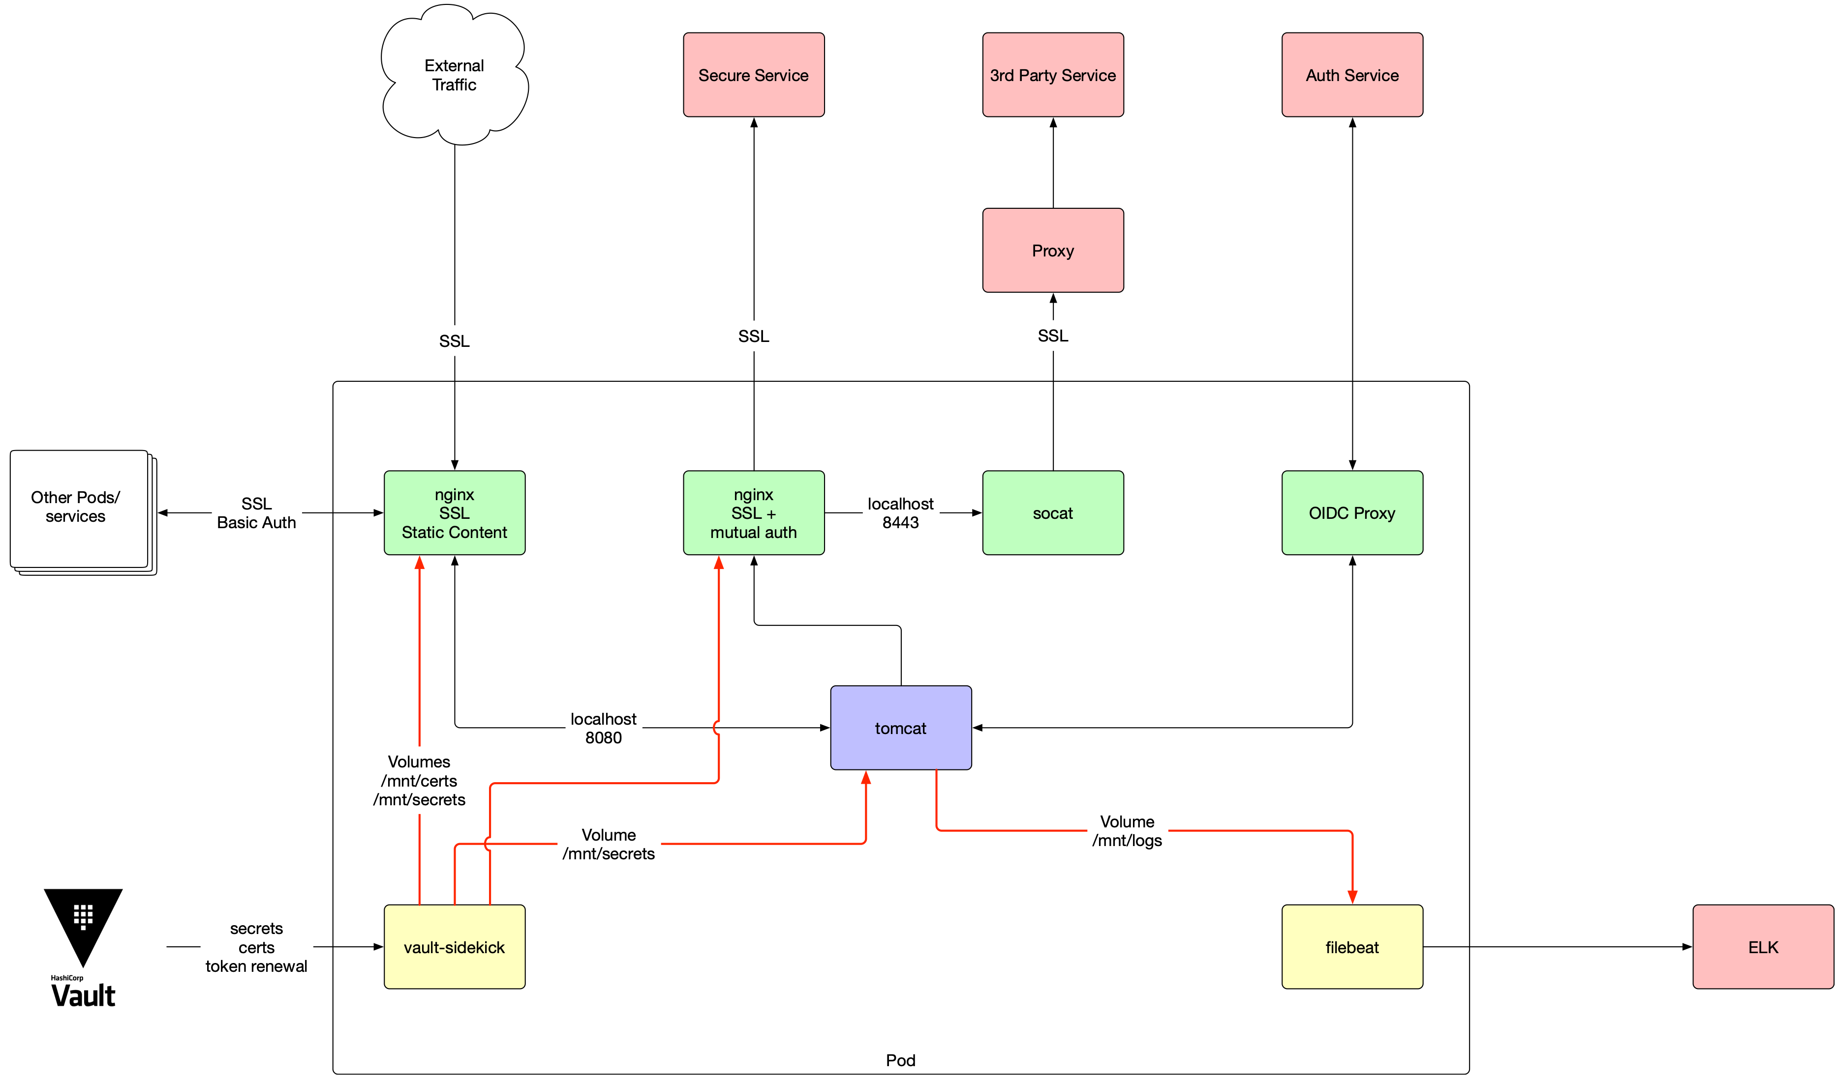
Sidecars
Notes:
Pragmatic Pod Patterns

Slide 33
Shift Left
Containers give you the most benefit if they’re used from the very start of your development pipeline.
They let devs deploy early (eg. locally) and often.
Delivery Teams can try new tools and techniques easily.
Put your tests, stubs and other artefacts in containers so that teams can use them locally.

Slide 34
Shift Left
Give developers access to the same orchestration tool used elsewhere - if you’re going to use Kubernetes give them access to a version of your cluster in a tool like minikube.
Give delivery teams the right information to make informed choices - if you already have an approved set of images, make sure they know what they are.
Give teams the tools to scan new images.
Have an open policy where new images can be discussed and approved.
Notes:
In terms of giving them a version include the same kind of setup and same version.
You don’t want teams working around issues or having huge Dockerfiles because they’re having to build in a lot of extra tools.

Slide 35
Securing the Supply Chain
Private Repositories (DTR, ECR etc.)
Strongly discourage —privileged mode
Docker Content Trust
Image hashes
Clair and third party tools like DTR, Aqua, Twistlock etc.
Admission Controllers/PodSecurityPolicy
Notes:
25 minutes in
Docker Trusted Repository
Mention the recent compromised container count from last year.

Slide 36
DEMO
Notes:
Demo of building the same Go container three times?
5 minutes

Slide 37
Be aware of interactions
JVM/Docker memory usage.
systemd

